Slide 1
Data Structures & Algorithms

Slide 2
Learning about algorithms and data structures will help you become better problem-solvers!

Slide 3
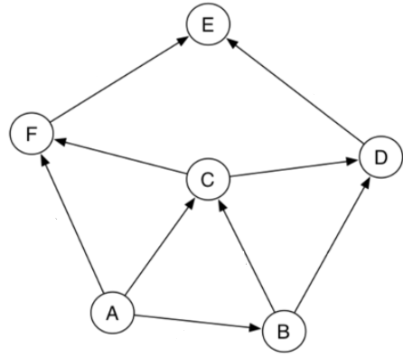
Application of Data Structures
Develop a reservation system where Seats are reserved based on a first come first serve basis
Find the shortest path from node B to other possible destinations

Slide 4
Observation
All programs manipulate data
process, store, display, gather
data can be information, numbers, images, sound
Each program must decide how to store data
Choice influences program at every level
execution speed
memory requirements
maintenance (debugging, extending, etc.)
Notes:
Given the importance of data, every program uses it, your knowledge of data structures affects what and how well you can program!
Moreover, it helps you understand what is possible to compute.

Slide 5
What this course is about ?
Data structures: conceptual and concrete ways to organize data for efficient storage and efficient manipulation
Employment of these data structures in the design of efficient algorithms

Slide 6
What is Efficiency?
A solution is said to be efficient if it solves the problem within its resource constraints.
Space
Time

Slide 7
Example
A collection of 3,000 texts with avg. of 20 lines each, with avg. 10 words / line
→ 600,000 words
Find all occurrences of the word “happy”
Suppose it takes 1 sec. to check a word for correct matching
What to do?

Slide 8
Example (cont’d)
What to do?
Sol. 1 Sequential matching: 1 sec. x 600,000 words = 166 hours
Sol. 2 Binary searching:
- order the words
- search only half at a time
Ex. Search 25 in 5 8 12 15 15 17 23 25 27
25 ? 15 15 17 23 25 27
25 ? 23 23 25 27
25 ? 25
How many steps?

Slide 9
Some example data structures
log ₂ 600000 = 19 sec. vs 166 hours!
Set
Stack
Tree
Data structure = representation and operations associated with a data type

Slide 10
Basic Conceptions
A Type is a collection of values
int: {0, 1, -1, 2, -2, …}
A Data Type is a Type and a collection of operations
Integer: {int, {+, -, *, …}}
An Aggregate Data Item is an element (of a Type) that contains one or more subitems

Slide 11
Basic Conceptions
An Abstract Data Type (ADT )is a definition of a Data Type
Specifies a Type
Specifies a set of operations
Does not specify internal details or the algorithms used to perform operations
A Data Structure is a particular organization of data implementing an ADT
Notes:
ADT is to an interface (what it does) what a data structure is to a class (how it does it).
ADT: List DS: ArrayList, LinkedList... ADT: Map DS: HashMap, TreeMap...

Slide 12
Foundations of Abstract Data Types
An abstract data type (ADT) is a set of objects together with a set of operations. For example:
Stack
Queue
Tree
Priority queue
12

Slide 13
What is a Data Structure?
A method of storage which provides (through a set of operations) functionality to manipulate the data in some useful way.
Notes:
A method of storage which provides through a set of operations functionality to manipulate the data in some useful way.

Slide 14
Need for Data Structures
Data structures help us to organize the data in the computer⇒ more efficient programs.
An efficient program executes faster and helps minimize the usage of resources like memory, disk.
Efficient.
Less use of recourses
Less time execution

Slide 15
View of the Data Organization
Linear : List,Stacks ,Queues
Logical Structure:
Non -Linear : Trees,Graphs
Array
Physical Structure:
Link
Notes:
A physical data structure refers to the actual organization of data on a storage device. The logical data structure refers to how the information appears to a program or user. For example, a data file is a collection of information stored together

Slide 16
How to solve a Problem?

Slide 17
Problem Solving
Problems can be solved by using a specific technique, which is called problem solving.
In this technique:
We need to understand the problem.

Slide 18
Problem Solving: Main Steps
Problem definition
Algorithm design / Algorithm specification
Algorithm analysis
Implementation
Testing
[Maintenance]

Slide 19
1. Problem Definition
What is the task to be accomplished?
Calculate the average of the grades for a given student
Understand the talks given out by politicians and translate them in Chinese
What are the time / space / speed / performance requirements ?

Slide 20
2. Algorithm Design / Specifications
Algorithm: Finite set of instructions that, if followed, accomplishes a particular task.
Describe: in natural language / pseudo-code / diagrams / etc.
Criteria to follow:
Input: Zero or more quantities (externally produced)
Output: One or more quantities
Definiteness: Clarity, precision of each instruction
Finiteness: The algorithm has to stop after a finite (may be very large) number of steps
Effectiveness: Each instruction has to be basic enough and feasible

Slide 21
The Definition of Algorithm
An algorithm is a finite sequence of instructions, each of which has a clear meaning and can be performed with a finite amount of effort in a finite length of time.
[Aho, Hopcroft & Ulman 1975]

Slide 22
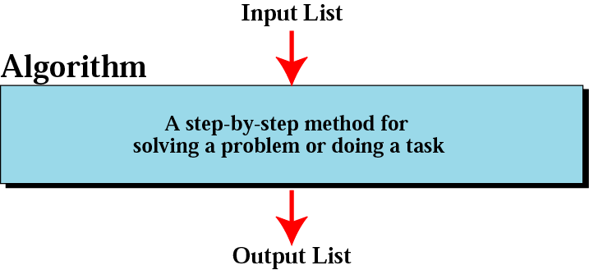
Informal definition of an algorithm
used in a computer

Slide 23
Expressing Algorithms
English description
Pseudo-code
High-level programming language
More
precise
More easily expressed

Slide 24
Pseudocode
Pseudocode is like a programming language but its rules are less stringent.
Written as a combination of English and programming constructs
Based on selection (if, switch) and iteration (while, repeat) constructs in high-level programming languages
Design using these high level primitives
Independent of actual programming language

Slide 25
3. Algorithm Analysis
Space complexity
How much space is required
Time complexity
How much time does it take to run the algorithm
Often, we deal with estimates!

Slide 26
Algorithm analysis
Basically, we want to solve any given problem using the fewest possible computer instructions.
Two algorithms may solve the same problem. One may take a few seconds while the other takes a few years. We will analyze our data structures to see why one works better than the other for a given set of data.
For example, we will learn several sort algorithms and analyze the efficiency of each.
Insertion sort
Merge sort
Quick Sort
Heap sort

Slide 27
4,5,6: Implementation, Testing, Maintainance
Implementation
Decide on the programming language to use
C, C++, Lisp, Java, Perl, Prolog, assembly, etc. , etc.
Write clean, well documented code
Test, test, test
Integrate feedback from users, fix bugs, ensure compatibility across different versions → Maintenance

Slide 28
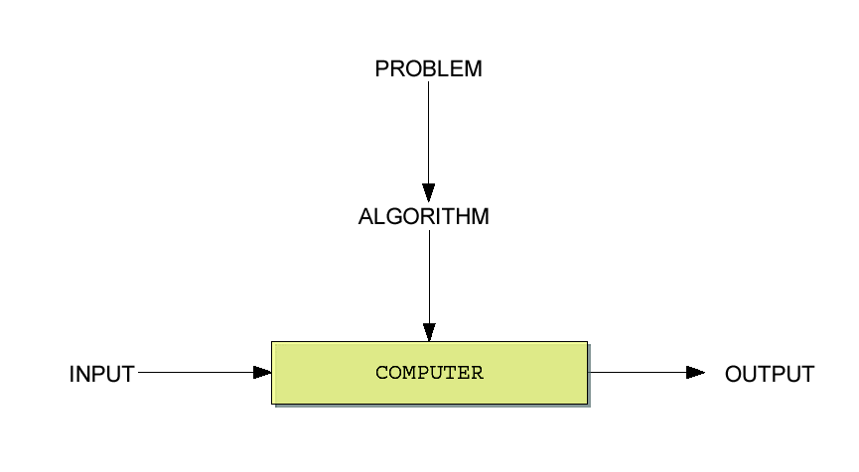
Algorithms and Computers

Slide 29
Why study algorithms?
The study of algorithms have been recognized as the cornerstone of computer science.
“Algorithmics is more than a branch of computer science. It is the core of computer science, and, in all fairness, can be said to be relevant to most science, business, and technology”

Slide 30
Reasons to study algorithms
Computer programs would not exist without algorithms.
Development of your analytical skills.
Improve the computer programs efficiency.

Slide 31
Algorithms and Computers
Algorithms are not answers but well defined steps for getting to answers.
Algorithms use DATA STRUCTURES.
Learning about algorithms and data structures will help you become better problem-solvers!

Slide 33
Arrays
The simplest type of data structure is a linear array.
Array is Linear Data Structure.
A data structure is said to be linear if its elements form a sequence.
An Array is fundamental of Abstract Data Type (ADT).
Collection of homogenous element in the form of Index/Value pairs stored in connective memory location.

Slide 34
Arrays
Array: a set of pairs (index and value)
data structure
For each index, there is a value associated with
that index.
representation (possible)
implemented by using consecutive memory.

Slide 35
Introducing Arrays
Array is a data structure that represents a collection of the same types of data.

Slide 36
Array Layout
x[0]
Array cells are contiguous in computer memory
The memory can be thought of as an array
x[1]
x[2]
x[3]
x[4]
x[5]

Slide 37
Representing One-Dimensional Array in Memory
Let A be a one-dimensional array with n elements. As Arrays are stored in consecutive memory locations.
Therefore there is no need to keep track of all addresses. However needs to keep track of first address.
Denoted by Base (A) and called the base address of A.
Using the Base address computer calculates of any element of Array A by using the
LOC (A[k]) = base(A) + w*k
Where w is the number of bytes per storage location for one element of the memory

Slide 38
Examples
Let the base address of the first element of the array is 400 and each element of the array occupy 2 bytes in the memory, then address of 4th element of array A[10] will be given as
Solution
Address of 4th element = 400 + 2*4
= 400 + 8
= 408
Here k is 4th element

Slide 39
Declaring Array Variables
datatype[] arrayRefVar;
Example:
double[] myList;
Example:
double myList[];

Slide 40
Creating Arrays
arrayRefVar = new datatype[arraySize];
Example:
myList = new double[10];
myList[0] references the first element in the array.
myList[9] references the last element in the array.

Slide 41
Declaring and Creating in One Step
datatype[] arrayRefVar = new
datatype[arraySize];
double[] myList = new double[10];
datatype arrayRefVar[] = new datatype[arraySize];
double myList[] = new double[10];

Slide 42
The Length of an Array
Once an array is created, its size is fixed. It cannot be changed. You can find its size using
arrayRefVar.length
For example,
myList.length returns 10

Slide 43
Default Values
When an array is created, its elements are assigned the default value of
0 for the numeric primitive data types,
'\u0000' for char types, and
false for boolean types.

Slide 44
Indexed Variables
The array elements are accessed through the index. The array indices are 0-based, i.e., it starts from 0 to arrayRefVar.length-1.
Each element in the array is represented using the following syntax, known as an indexed variable:
arrayRefVar[index];

Slide 45
Using Indexed Variables
After an array is created, an indexed variable can be used in the same way as a regular variable. For example, the following code adds the value in myList[0] and myList[1] to myList[2].
myList[2] = myList[0] + myList[1];

Slide 46
Array Initializers
Declaring, creating, initializing in one step:
double[] myList = {1.9, 2.9, 3.4, 3.5};
This shorthand syntax must be in one statement.

Slide 47
Declaring, creating, initializing Using the Shorthand Notation
double[] myList = {1.9, 2.9, 3.4, 3.5};
This shorthand notation is equivalent to the following statements:
double[] myList = new double[4];
myList[0] = 1.9;
myList[1] = 2.9;
myList[2] = 3.4;
myList[3] = 3.5;

Slide 48
CAUTION
Using the shorthand notation, you have to declare, create, and initialize the array all in one statement. Splitting it would cause a syntax error. For example, the following is wrong:
double[] myList;
myList = {1.9, 2.9, 3.4, 3.5};

Slide 49
Processing Arrays
See the examples in the text.
(Initializing arrays)
(Printing arrays)
(Summing all elements)
(Finding the largest element)
(Finding the smallest index of the largest element)

Slide 50
Enhanced for Loop
JDK 1.5 Feature
JDK 1.5 introduced a new for loop that enables you to traverse the complete array sequentially without using an index variable. For example, the following code displays all elements in the array myList:
for (double value: myList)
System.out.println(value);
In general, the syntax is
for (elementType value: arrayRefVar) {
// Process the value
}
You still have to use an index variable if you wish to traverse the array in a different order or change the elements in the array.

Slide 51
Example: Testing Arrays
Objective: The program receives 6 numbers from the user, finds the largest number and counts the occurrence of the largest number entered.
Suppose you entered 3, 5, 2, 5, 5, and 5, the largest number is 5 and its occurrence count is 4.

Slide 52
Example: Assigning Grades
Objective: read student scores (int), get the best score, and then assign grades based on the following scheme:
Grade is A if score is >= best–10;
Grade is B if score is >= best–20;
Grade is C if score is >= best–30;
Grade is D if score is >= best–40;
Grade is F otherwise.

Slide 53
Copying Arrays
Often, in a program, you need to duplicate an array or a part of an array. In such cases you could attempt to use the assignment statement (=), as follows:
list2 = list1;

Slide 54
Passing Arrays to Methods
public static void printArray(int[] array) {
for (int i = 0; i < array.length; i++) {
System.out.print(array[i] + " ");
}
}
Invoke the method
int[] list = {3, 1, 2, 6, 4, 2};
printArray(list);
Invoke the method
printArray(new int[]{3, 1, 2, 6, 4, 2});
Anonymous array

Slide 55
Anonymous Array
The statement
printArray(new int[]{3, 1, 2, 6, 4, 2});
creates an array using the following syntax:
new dataType[]{literal0, literal1, ..., literalk};
There is no explicit reference variable for the array. Such array is called an anonymous array.

Slide 56
Pass By Value
Java uses pass by value to pass parameters to a method. There are important differences between passing a value of variables of primitive data types and passing arrays.
For a parameter of a primitive type value, the actual value is passed. Changing the value of the local parameter inside the method does not affect the value of the variable outside the method.
For a parameter of an array type, the value of the parameter contains a reference to an array; this reference is passed to the method. Any changes to the array that occur inside the method body will affect the original array that was passed as the argument.

Slide 57
Simple Example
public class Test {
public static void main(String[] args) {
int x = 1; // x represents an int value
int[] y = new int[10]; // y represents an array of int values
m(x, y); // Invoke m with arguments x and y
System.out.println("x is " + x);
System.out.println("y[0] is " + y[0]);
}
public static void m(int number, int[] numbers) {
number = 1001; // Assign a new value to number
numbers[0] = 5555; // Assign a new value to numbers[0]
}
}

Slide 58
Returning an Array from a Method
public static int[] reverse(int[] list) {
int[] result = new int[list.length];
for (int i = 0, j = result.length - 1;
i < list.length; i++, j--) {
result[j] = list[i];
}
return result;
}
list
result
int[] list1 = new int[]{1, 2, 3, 4, 5, 6};
int[] list2 = reverse(list1);

Slide 59
Operation on array
All the operations such as traversing, insertion, deletion, sorting, and merging can be performed on linear array.
Traversing ( print all the array elements one by one )
Traversing is the process of visiting each element of the array exactly one, i.e., starting from first element up to the last element.
Insertion (add an element at given index)
Deletion (delete an element at given index)
Sorting (arrange the data items in some order)
Searching (find out the location of the data item)
Merging (combine the data items of two sorted arrays into single array)

Slide 60
Array operations
Traversing
Insertion
Searching
Deleting

Slide 61
Traversing a linear Array
Consider A be a collection of data elements stored in the memory of the computer.
Suppose we want to either print the contents of each element of A or to count the number of elements of A with a given property. This can be accomplished by traversing A, that is, by accessing and processing (frequently called visiting) each element of A exactly once.

Slide 62
Algorithm for Array Traversal
Let A be a linear Array with Lower Bound LB and Upper Bound UB.
The following algorithm traverses A applying an operations PROCESS to each element of A
Step 1. Initialize Counter
Set Counter = LB
Step 2. Repeat steps 3 and 4 while counter <= UB
Step 3. Visit element
Apply PROCESS to A[counter]// You can do operations of data item
Step 4. Increase Counter
Set counter = counter + 1
Step 5. Exit
A[0]
A[1]
A[2]
A[3]
A[4]
A[5]

Slide 63
Insertion and deletion in a Linear Array
Let A be a collection of data elements in the memory of the computer.
“Insertion” refers to the operation of adding another element to the collection A, and
“deletion” refers to the operation of removing one of the elements from A.

Slide 64
Insertion in an Array
Inserting an element at the “end” of a linear array can be easily done provided the memory space allocated for the array is large enough to accommodate the additional element.
On the other hand, suppose we need to insert an element in the middle of the array. Then, on the average, half of the elements must be moved downward to new locations to accommodate the new element and keep the order of the other elements.

Slide 65
Cont . . .
Example
Consider TEST has been declared as a 5-element array but data have been recorded only for TEST [1]=10, TEST [2]=5, and TEST [3]=8.
If X is the value to the next element, then we may simply assign, TEST [4] = X to add X to the Linear Array. Similarly, if Y is the value of the subsequent element, then we may assign, TEST [5] = Y to add Y to the Linear Array.

Slide 66
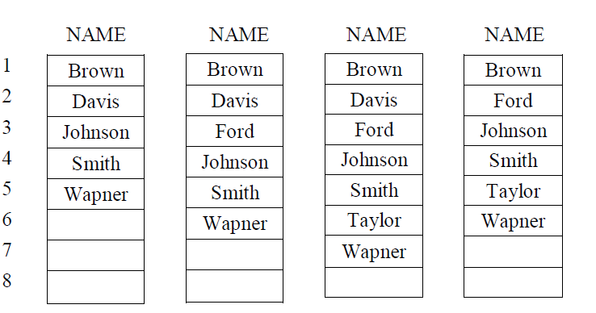
Example
Insertion in Middle of an Array (Insert “Ford” at 3rd location)
Insertion of an Array
(Insert “Taylor” at 6th location)
Deletion of element from an Array (Delete “Davis” from 2nd location)

Slide 67
Algorithm for insertion
Let A be a Linear Array, N is number of elements, k is the positive integer such that k<=N, VAL to insert element at kth Position in an Array A
Step 1. Start
Step 2. Initialize Counter
Set J = N
Step 3. Repeat Steps 3 and 4 while J>=k
Step 4. Move Jth element downward
Set A[J+1] = A[J]
Step 5. Decrease Counter
Set J = J - 1
End of step 2 loop
Step 6. Insert element
Set A[k] = ITEM
Step 7. Reset N
Set N = N + 1
Step 8. Exit
A[0]
A[1]
A[2]
A[3]
A[4]
A[5]

Slide 68
Deletion Algorithm
Let A be an linear Array. N is the number of elements, k is the positive integer such that k<=N. The algorithm deletes kth element from the Array.
Step 1. Start
Step 2. Set VAL = A[k]
Step 3. Repeat for J = k to N-1
[Move J+1 element Upward]
Set A[J] = A[J+1)
End of Loop
Step 4. Reset the number N of elements in A
Set N = N– 1
Step 5. Exit
A[0]
A[1]
A[2]
A[3]
A[4]
A[5]

Slide 69
Searching in Linear Array
Suppose A is linear Array with N elements, and VAL is the given item of information. This algorithm finds the location LOC of item in A or sets LOC=0 if search is unsuccessful
Step 1. Start
Step 2. [Initialize counter and VAL]
SET LOC = 0
VAL=item to search
Step 3. [Search for VAL]
Repeat while LOC<N
If A[LOC] = VAL
[print LOC]
Break
Else
Print [not found]
End if
End of loop
Step 6. Exit
A[0]
A[1]
A[2]
A[3]
A[4]
A[5]

Slide 70
Advantages and Limitations
Advantages
Searching is faster as elements are in continuous memory locations.
Memory Management is taken care of by the compiler itself.
no need to keep track of all addresses. But need to keep track of first address which is called Base address.
Limitations
Number of elements must be known in advance.
Inserting and Deleting are costly as it involves shifting the rest of the elements.

Slide 71
